Slide 1
Cse 316
Design
Review

Slide 2
Software Development Life Cycle
We're making progress
Requirements Analysis
Design & Document
Evaluate Design
Code
Test
Deploy
Profile
Debug

Slide 3
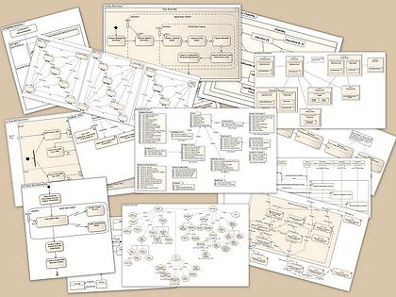

Evaluating a Design
During the design of a large program, it is worthwhile to step back periodically & attempt a comprehensive evaluation of the design so far
called a design review
Notes:
http://blog.architexa.com/2010/04/determining-which-uml-diagram-to-use/

Slide 4
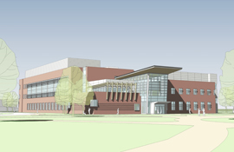
Design Reviews are not just for Software

Slide 5

Who performs the design review?
Design review committee
Members should include:
varied perspectives
some from the project
some external to the project
All should be familiar with the design itself
Write up a TPS report for management
Notes:
http://globalhealtheducation.org/committees/Pages/default.aspx

Slide 6


One World Trade Center

Slide 7
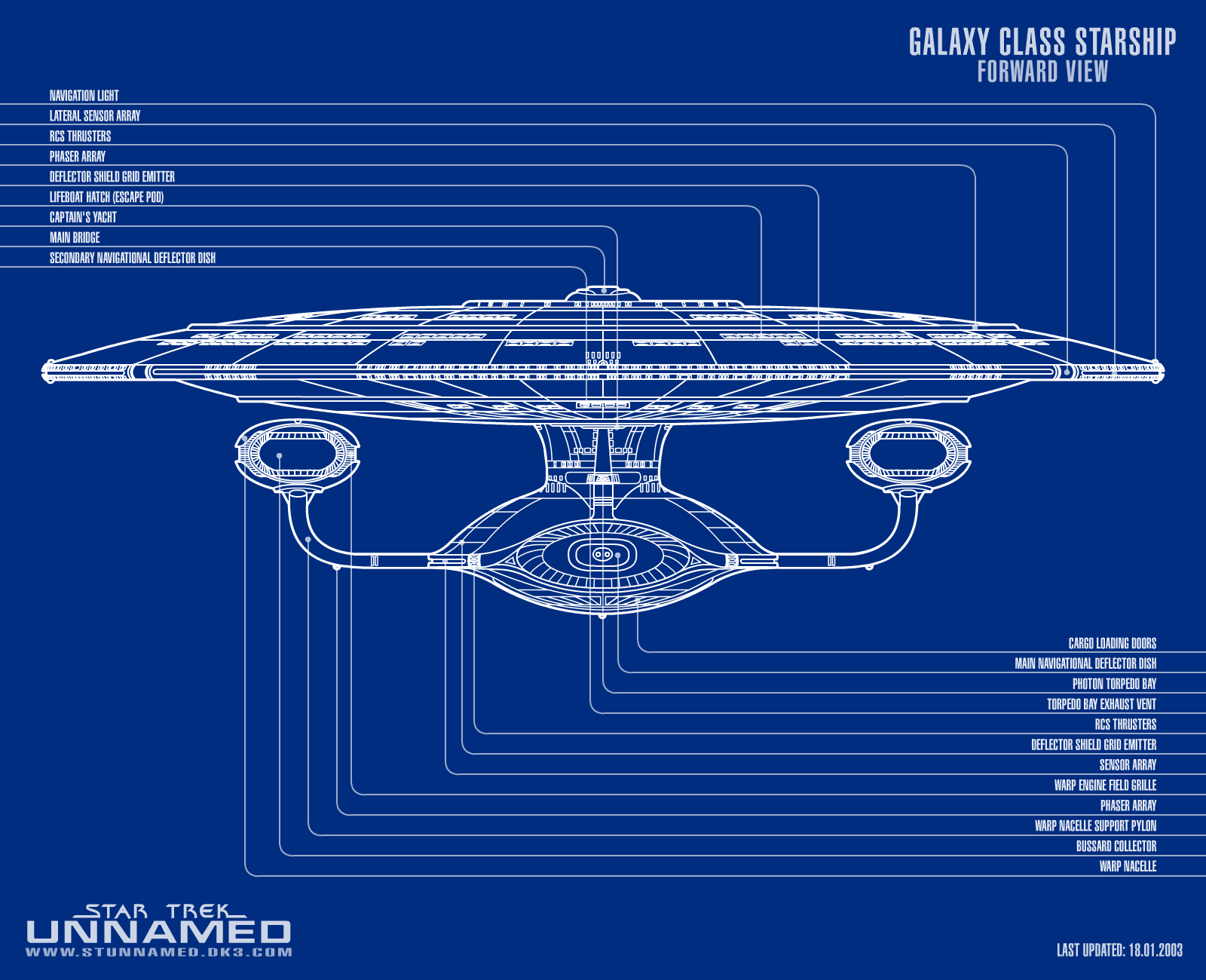
There is no perfect design
Is the design adequate?
Will do the job with adequate performance & cost?
Notes:
http://www.utopiaplanitia.info/blueprints/1701d/original/galaxy_forward.gif

Slide 8
Critical Design Issues
Is it correct?
Will all implementations of the design exhibit the desired functionality?
Is it efficient?
Are there implementations of the design that will be acceptably efficient?
Is it testable & maintainable?
Does the design describe a program structure that will make implementations reasonably easy to build, test and maintain?
Is it modifiable, extensible, & scalable?
How difficult will it be to enhance the design to accommodate future modifications?

Slide 9
Other Considerations
Are the classes independent?
Is there redundancy?
Do they manage & protect their own data?
Can they be tested individually?
Do they promote code reuse?
Is data and control flow clear or complex?

Slide 10
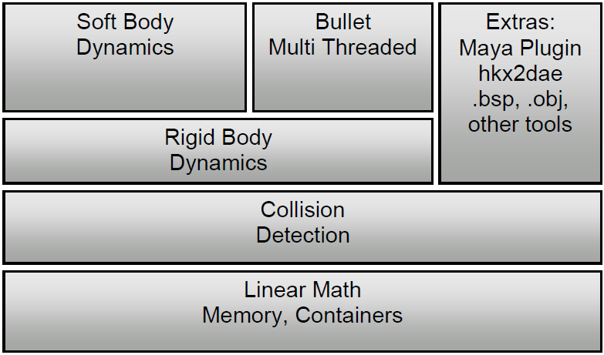
It all starts with a Modular Design
Large software projects are divided up into separate modules
i.e. groups of related classes

Slide 11
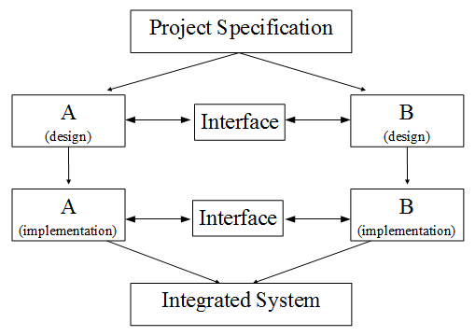
Modular Design Methodology
Decompose
large programming problems into smaller ones
i.e. sub-problems
Solve
the sub-problems independently
modules solve sub-problems
Assemble
the modules to build full system
called system integration
scariest parts of software development
serious design flaws can be exposed

Slide 12
Modular Design
Project Specification
A
(design)
B
(design)
Interface
A
(implementation)
B
(implementation)
Interface
Integrated System

Slide 13
What makes a good modular design?
Connections between modules are explicit
Connections between modules are minimized
called narrow interfaces
Modules use abstraction well
Implementation of modules can be done independently
modules avoid duplication of effort

Slide 14
More on Narrow Interfaces
A module should have access to only as much information as it needs to work
less chance of misuse
less coordination needed between team members
fewer meetings necessary (YAY!)
A
B
Interface
A
B
Interface

Slide 15
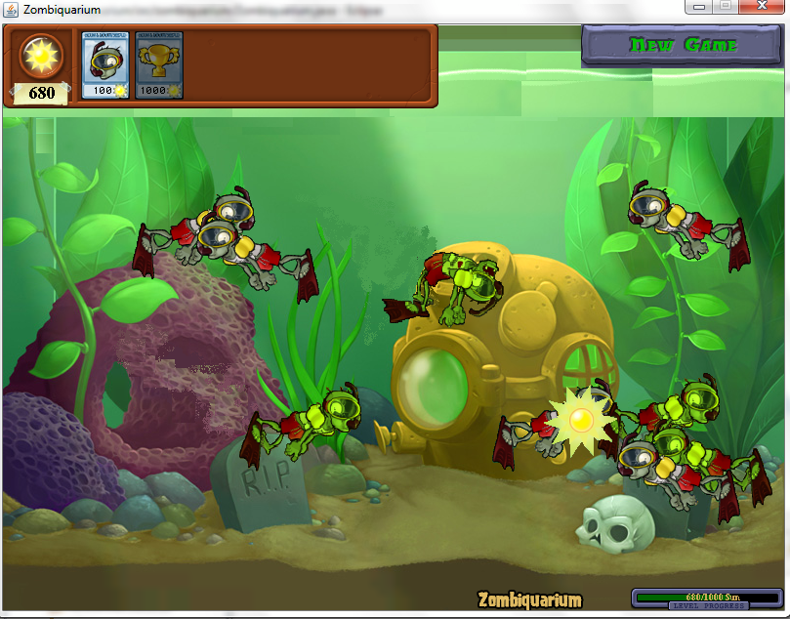
Design is Difficult
Where do you begin?
When is the design complete?

Slide 16
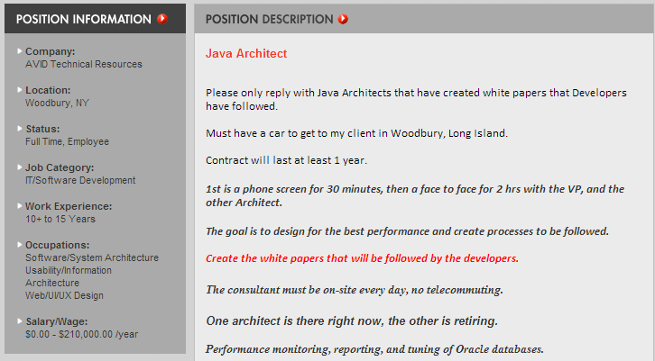
Good Design comes with Experience
It takes time to become an expert

Slide 17
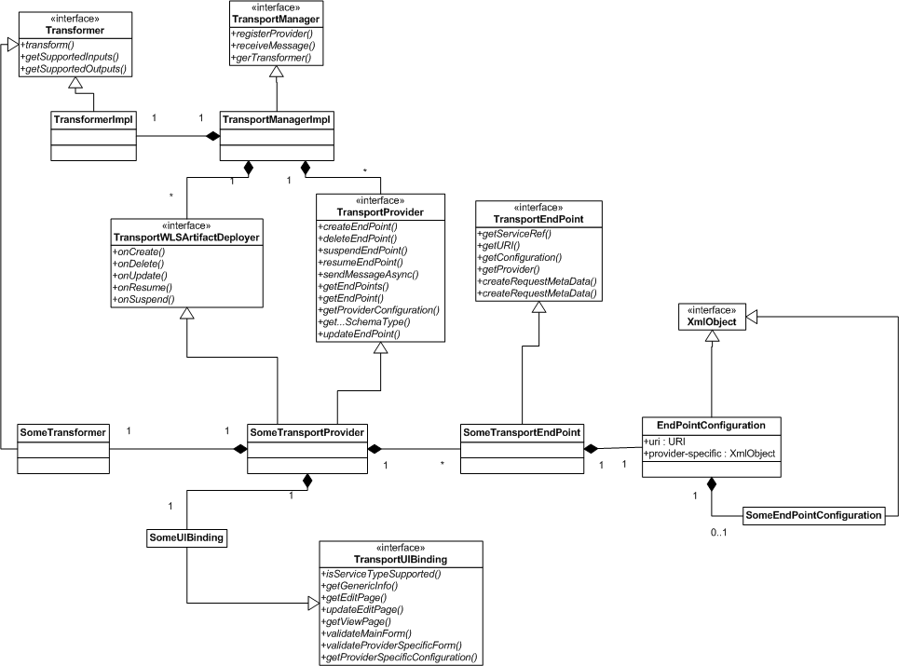
How can a design be reviewed for correctness?
Testing is not possible
Verification is not possible
unless it uses a formal language
typically not practical
Use proven, systematic procedure
examine both local & global properties of the design
?

Slide 18

Local Properties
Studying individual modules
Important local properties:
consistency
everything designed was as specified
completeness
everything specified was designed
performance
running time
storage requirements

Slide 19

Global Properties
Studying how modules fit together
after examining local properties
Notes:
http://www.medusawebsolutions.com/Images/puzzle-pieces.JPG

Slide 20

Global Properties to Consider
Is all the data accounted for?
from original SRS
exists properly in a module
rules are properly enforced
Trace paths through the design
walk-through
select test data
Does control flow properly through the design?
Does data flow properly through the design?

Slide 21
Reviewing Design Structure
Two key questions:
Is there an abstraction that would lead to a better modularization?
Have we grouped together things that really do not belong in the same module?
Structural Considerations
Coherence of procedures
Coherence of types
Communication between modules
Reducing dependencies

Slide 22
Coherence of procedures
A procedure (method) in a design should represent a single, coherent abstraction
Indicators of lack of coherence:
if the best way to specify a procedure is to describe how it works
if the procedure is difficult to name
Arbitrary restrictions:
length of a procedure
method calls in a procedure

Slide 23
Coherence of Types
Examine each method to see how crucial it is for the data type
does it need to access instance or static variables of the class
Move irrelevant methods out to another location
Common with static functions

Slide 24
Communication between Modules
Careful examination can uncover important design flaws
think of handing your HW 4 Design to another student for inspection
Do these pieces really fit together?
to improve any design:
act like a jerk when examining your own design
ask questions that a jerk would ask
make sure your design addresses these jerky questions

Slide 25
Reducing Dependencies
A design with fewer dependencies is generally better than one with more dependencies.
What does this mean?
Make the design of each component dependent on as few other components as necessary
Example of bad framework design:
Every class in your framework uses every other class in your framework in one way or another
This would be terribly complex to test & modify

Slide 26
Look for Antipatterns
Common patterns in programs that use poor design concepts
make reuse very difficult
source: http://www.antipatterns.com/
Ex:
The Blob
Spaghetti Code

Slide 27
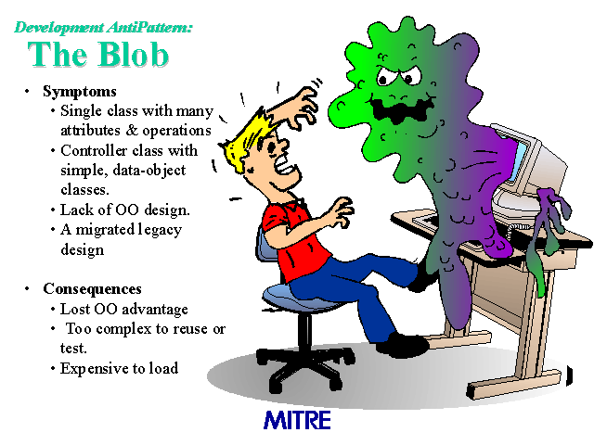

Slide 28
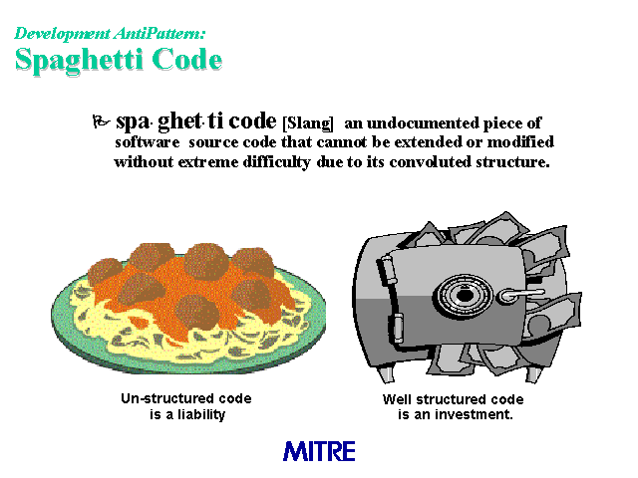

Slide 29
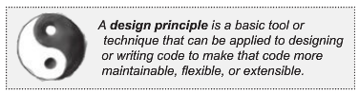
Design Principles
Cohesion
The Open-Closed Principle
The Don’t Repeat Yourself Principle
The Single Responsibility Principle
The Liskov Substitution Principle

Slide 30
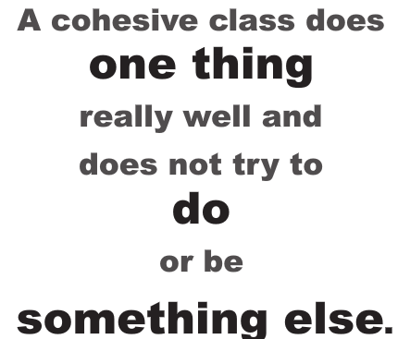
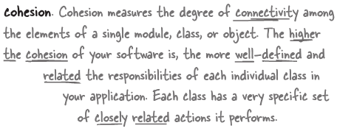

Slide 31
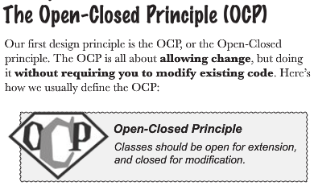

Slide 32
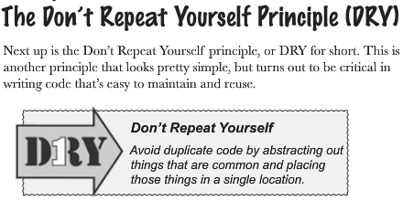
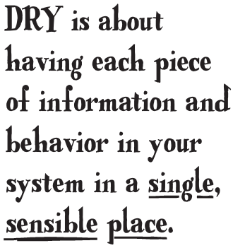

Slide 33
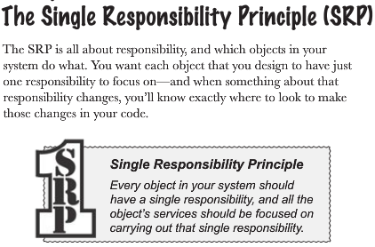

Slide 34
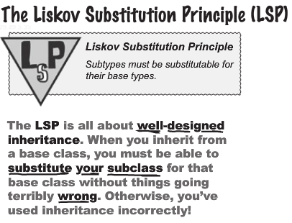

Slide 35
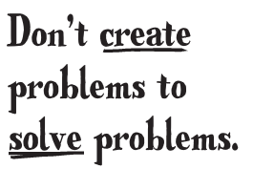
One more principle

Slide 36
These principles may lead to making a framework
Application A
-pushTransactionOnStack(…
-execMoveItem(…
Application B
-pushTransactionOnStack(…
-execUpdateTransaction(…

Slide 37
These principles may lead to making a framework
Transaction Framework
Transaction<I>
do(…);
jsTPS
addTransaction(…
transaction.do(…
Application A
Application B
MoveiItemTransaction
do(…);
UpdateTransaction
do(…);

Slide 38
So what's left?
CI/CD and Test Driven Development
Design Patterns

